Slide 1

PERSONAL DATA EXPIRY PIPELINE: DYNAMIC DATA MANAGEMENT
Course: Advanced Data Engineering (J-Component)
Faculty: Prof. Siva Kumar V
Team Members: Koushik J (22MID0235), Siva sharan U (22MID0345), Sushank S N (22MID0348)

Slide 2

THE PROBLEM: INDEFINITE DATA RETENTION
STALE INFLUENCE
User activities stored indefinitely cause outdated data to heavily influence system behavior, leading to inaccurate predictions.
DEGRADED EXPERIENCE
Incorrect recommendations and irrelevant notifications frustrate users, reducing engagement and satisfaction.
PRIVACY CONCERNS
Keeping personal data forever raises significant privacy and security risks for both users and organizations.
RIGID SYSTEMS
Fixed data deletion periods fail because they do not align with real, dynamic user behavior patterns.

Slide 3

THE ABSTRACT: DYNAMIC DATA EXPIRY
Our system revolutionizes personal data management by introducing dynamic expiry. It tracks real-time behavior signals and applies advanced time-decay logic to ensure data relevance.
Data is dynamically adapted based on continuous user interactions, rather than static rules. This creates a truly adaptive data management system that evolves with user preferences.

Slide 4

CORE OBJECTIVES
DYNAMIC EXPIRY LOGIC
BEHAVIORAL TRACKING
TIME-DECAY ALGORITHMS
Assign expiry logic based on behavioral relevance rather than fixed time periods.
Update user preferences actively from recent interactions and behaviors.
Reduce the influence of old data unless reinforced by new behavior patterns.
TIERED DATA STORAGE
QUERY FILTERING
Organize data intelligently into Hot, Warm, Cold, and Delete layers based on relevance.
Exclude expired data to maintain pinpoint accuracy in recommendations and queries.

Slide 5





SYSTEM ARCHITECTURE FLOW
DATA COLLECTION
Captures searches, watches, clicks, and purchases via user activity logs.
ETL PIPELINE
Extracts, cleans, transforms, and loads behavioral data for processing.
RELEVANCE & DECAY ENGINE
Analyses behaviors using time-decay algorithms to sideline old data.
REINFORCEMENT TRACKER
Identifies and reinforces repeated user behaviors to keep relevant data alive.
QUERY ENGINE
Filters out expired traits and routes relevant data to consumer applications.
Consumer applications include Streaming platforms, Job Portals, and E-Commerce systems.

Slide 6
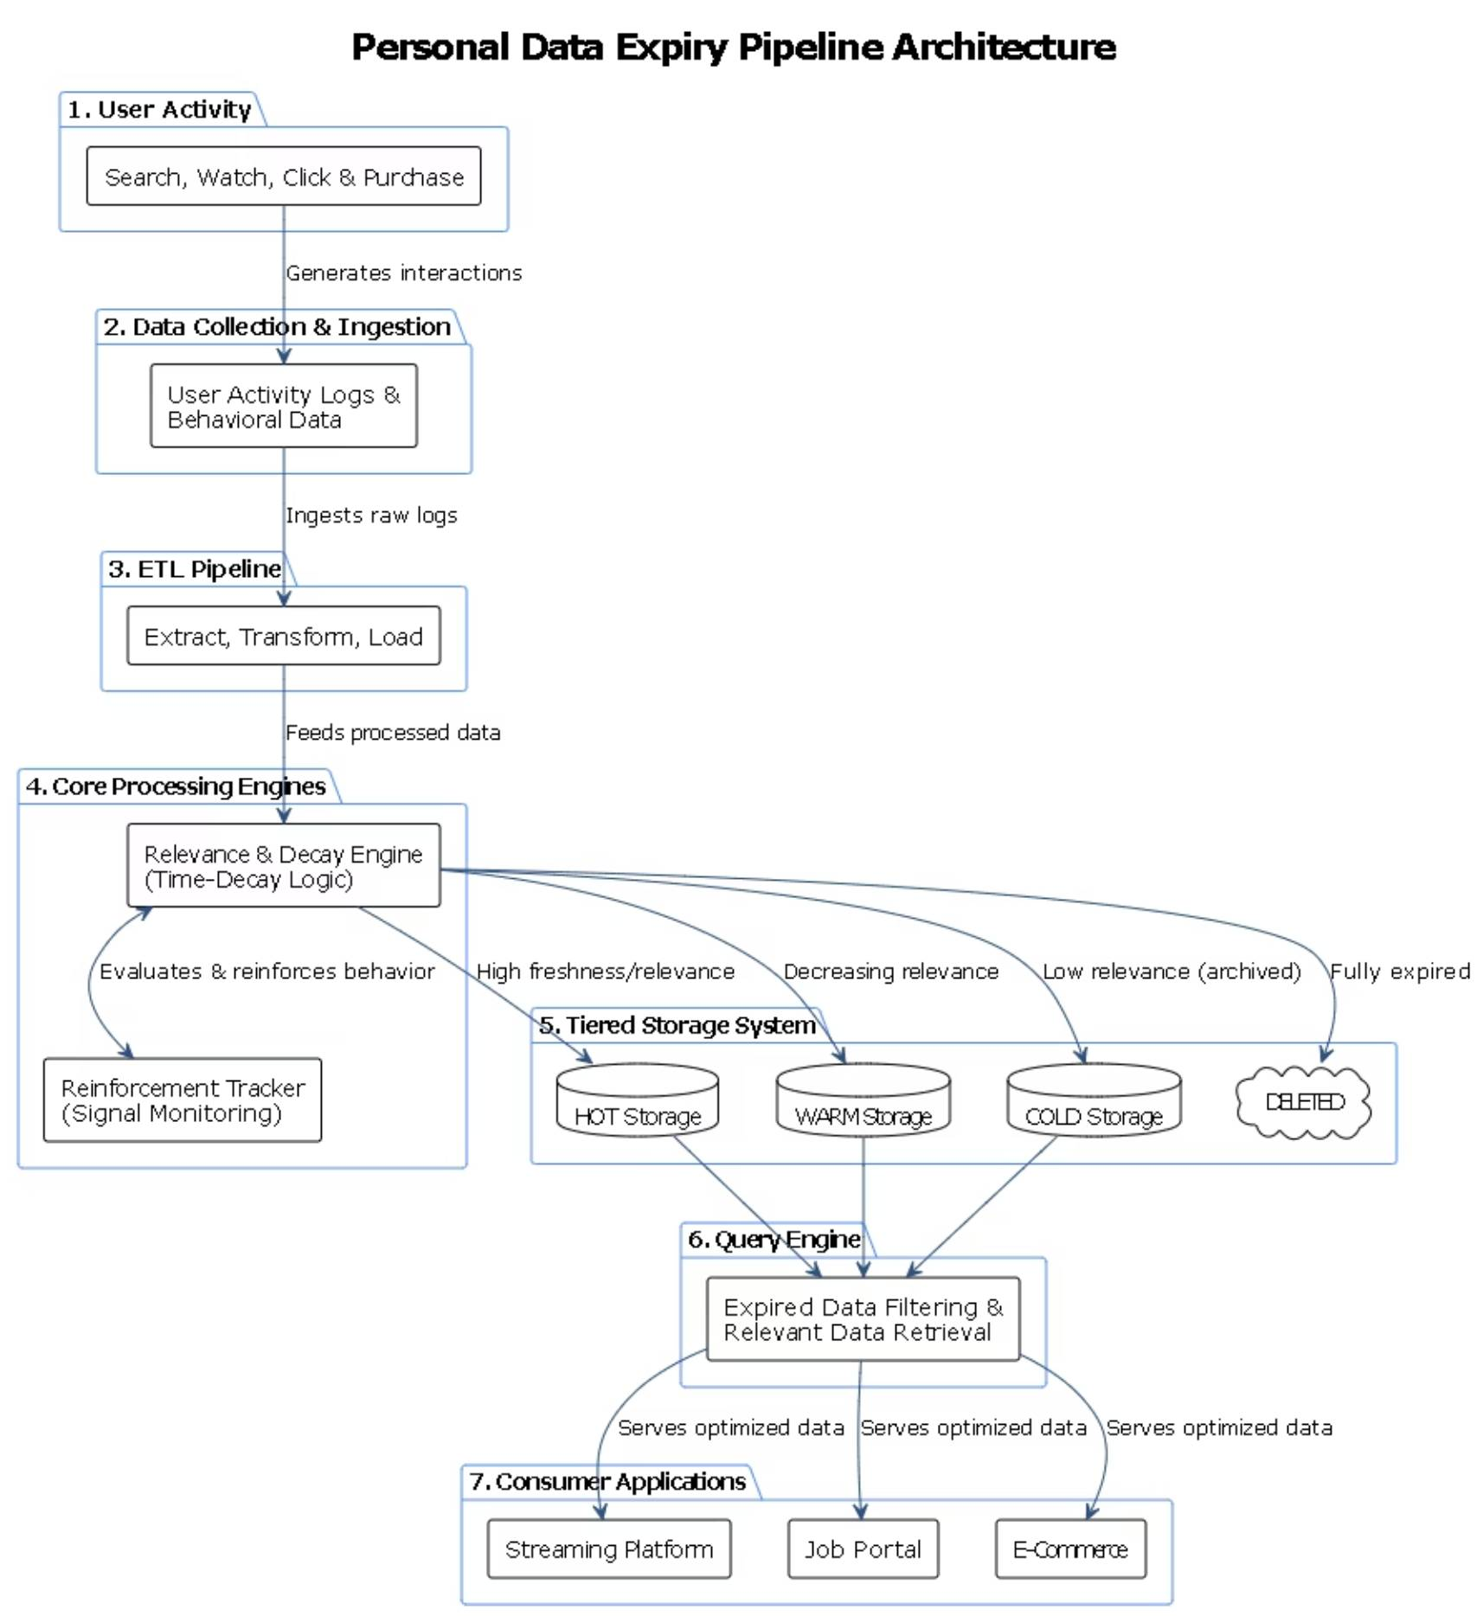

Slide 7




THE INNOVATIVE SOLUTION: BEHAVIOR-BASED EXPIRY
BEHAVIORAL RELEVANCE TRACKING
AUTOMATIC DATA DEGRADATION
REINFORCEMENT-BASED SURVIVAL
TIERED STORAGE EFFICIENCY
Gradually reduces the influence of older data using mathematical time-decay functions.
Retains data only if tied to repeated, ongoing user behaviors and interactions.
Moves data through Hot, Warm, and Cold layers based on its freshness score.
Continuously assesses data importance based on shifting user patterns and preferences.

Slide 8

LITERATURE SURVEY & THE MISSING LINK
CURRENT RESEARCH LANDSCAPE
Recent studies focus heavily on Time-Decay Collaborative Filtering (2024) and Temporal Latent Sequential Networks (2021).
Existing models excel at capturing time-based preference changes and temporal patterns in user behavior.
THE BEHAVIORAL GAP
Most methods rely purely on time weighting. They severely lack the behavioral reinforcement mechanisms required to accurately model complex user patterns over time.

Slide 9

CONCLUSION & PROJECT OUTCOMES
ENHANCED ACCURACY
Focusing strictly on relevant, recent data drastically improves the precision of recommendations and predictions.
BETTER USER EXPERIENCE
Highly accurate recommendations lead to increased engagement and satisfaction in consumer applications.
DATA EFFICIENCY
Automatic expiry significantly reduces server storage needs and cuts operational costs.
UPGRADED PRIVACY
Limiting data retention inherently protects user privacy and supports smarter, safer data management practices.

Slide 10
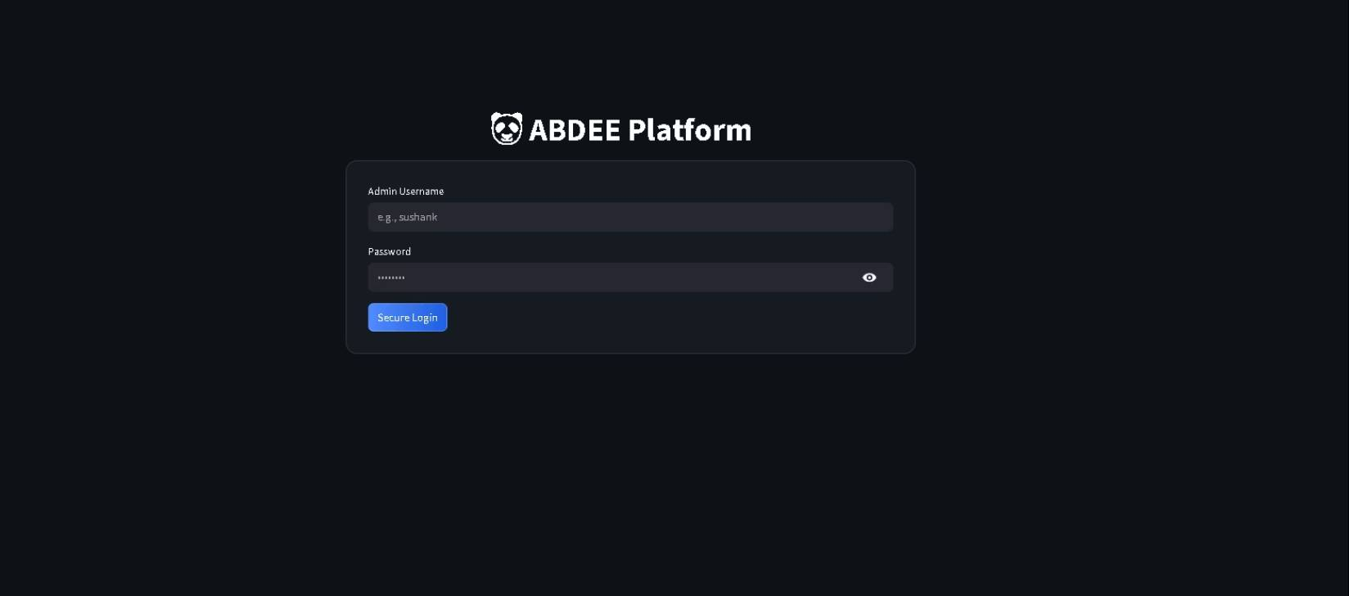

Login Pages for ABDEE Platform & Streaming Platform
Dashboard for ABDEE platform which is used for logging in to the project
the initial user interface of the PandaStream application, which serves as the consumer-facing module of the proposed system

Slide 11
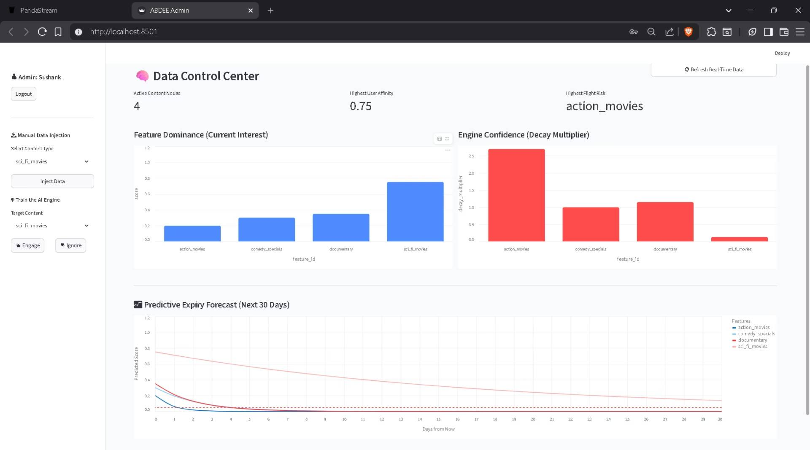
RESULTS
ABDEE Dashboard
The above figure illustrates the Data Control Center, which serves as the administrative interface of the system. This module provides a comprehensive view of system-level metrics, including active content nodes, user affinity scores, and high-risk features based on decay behavior

Slide 12
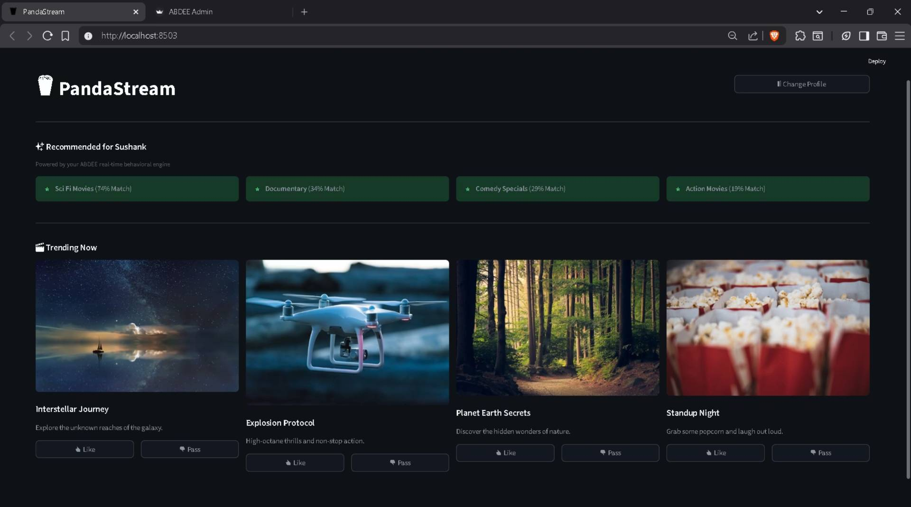
STREAMING PLATFORM
The above figure demonstrates the user interaction interface where content is presented along with feedback options such as “Like” and “Pass.” These interactions serve as explicit behavioral signals that are captured by the system in real time.

